Slide 1
How to use experimental data for CFD comparison?
Sandia National Laboratories
Joonsik Hwang
Zachary Buen

Slide 2
Introduction
Users need access to MATLAB.
Data set contains 6 different ECN Spray G conditions (G1, G2, G3, G2-cold, G3-cold, and G3-double).
Liquid/vapor penetration and width data for iso-octane (ic8) and 3-components surrogate fuel (n-pentane 36%, iso-octane 46%, n-undecane 18% (v/v)) is available.
Liquid volume fraction (LVF) at 11 different planes (Z=2, 5, 8, 10, 12, 15, 20, 30, 40, 50, 60mm) enabled by Sandia 3D-CT is also available.
Part I will introduce liquid/vapor penetration and width data.
Part II will introduce 3D-CT data.
Part III will introduce in-chamber temperature under G1 condition

Slide 3
Part I: liquid/vapor characterization
Sandia National Laboratories
Joonsik Hwang

Slide 4
Data type
liquid_data_2e-4_thr.mat is data containing liquid width at (Z=15, 25, 35mm) and liquid penetration length based on projected liquid volume threshold of 0.2e-3.
liquid_data_2e-3_thr.mat is data containing liquid width at (Z=15, 25, 35mm) and liquid penetration length based on projected liquid volume threshold of 2e-3.
Please refer a presentation at ECN 6.3 by Lukas Weiss https://ecn.sandia.gov/ecn-workshop/ecn7-workshop/ for image processing.

Slide 5
If you open liquid_data_2e-4_thr.mat…
We have two variables: axis_title and liquid_data_low_thr
axis_title indicates what do we have in each column of liquid_data_low_thr
Basic format is time (ms), data (width or length), standard deviation, and 95% probability of the data.
We have liquid width at Z=15, 25, 35mm and then liquid length defined by 3 different methods.

Slide 6
Understanding of liquid penetration data
Columns 14, 15, 16 indicate liquid penetration length.
Column 14 was defined as a liquid length between nozzle tip and axial farthest length in an image of averaged PLV from 300 injections.
Column 15 was defined as an averaged liquid length from 3 groups (plumes (2,3,4), (1,5), (6,7,8)) based on an image of averaged PLV from 300 injections.
Column 16 was defined as an averaged liquid length from instantaneous PLV images of 300 injections.

Slide 7
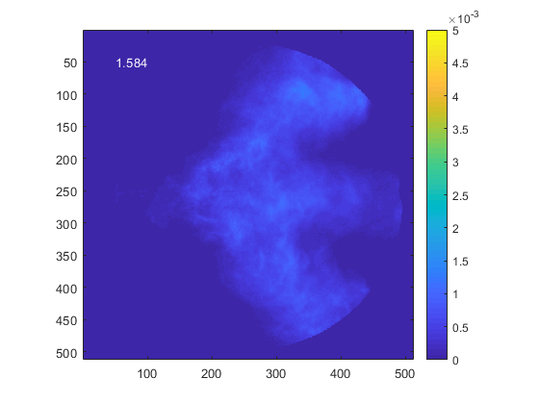
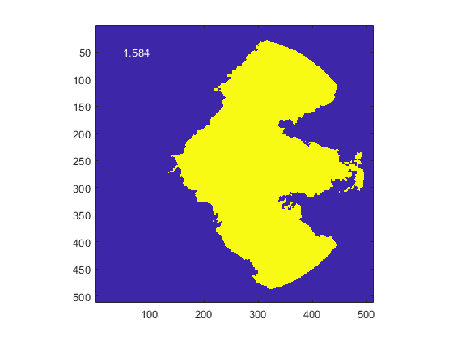
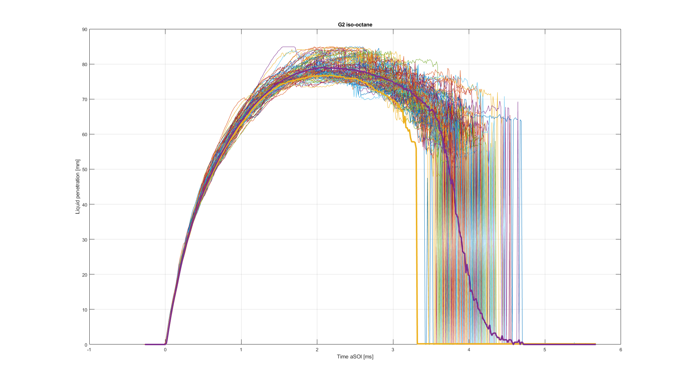
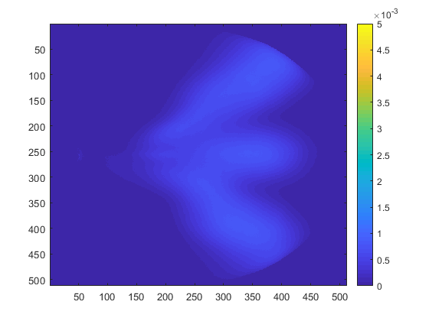
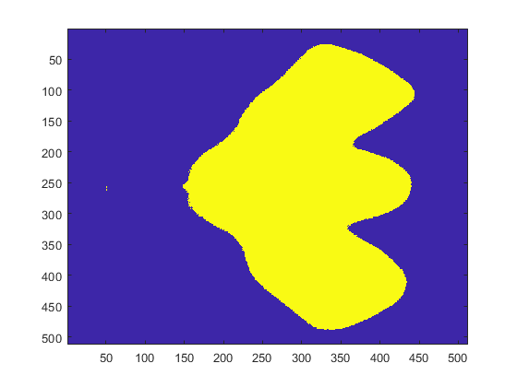
Example
Column 16
Measure by instantaneous PLV and average Column 16
PLV
Binarized
Column 14
Binarized
Avg. PLV and measure
Column 14
PLV
Column 15
Take average of 3 groups
Column 16 is usually larger than column 14 since detailed features of instantaneous spray is remaining.
Binarized

Slide 8
If you open vapor_data.mat…
We have two variables: axis_title and vapor_data
axis_title indicates what do we have in each column of vapor_data
Basic format is time (ms), data (width or length), standard deviation, and 95% probability of the data.
We have liquid width at Z=15, 25, 35mm and then vapor length defined by 2 different methods. – likewise liquid length, average length from individual injections (column 12) and averaged from 3 groups (column 11)

Slide 9
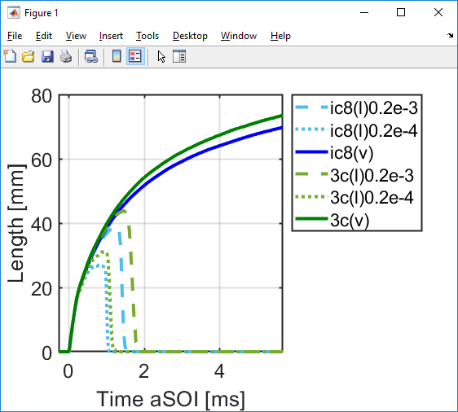
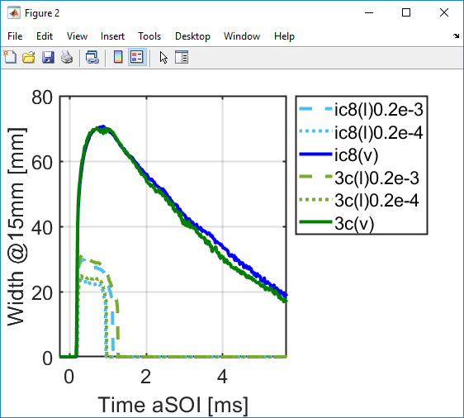
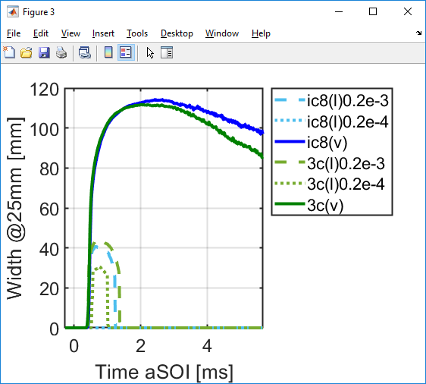
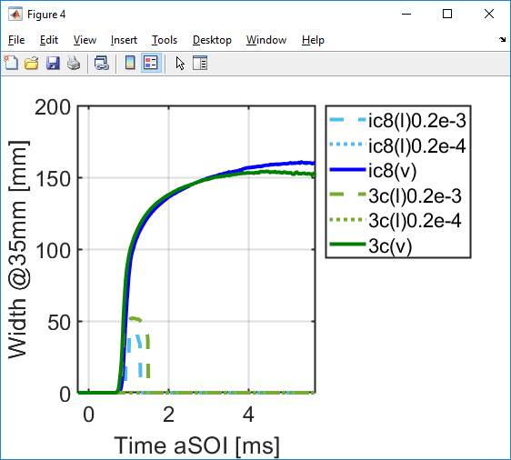
Plotting practice
Download liquid and vapor data and run one of example code for length comparison.
Please change file inventory to where you download data.
For example, length_G1_comparison.m will produce,

Slide 10
Part II: 3D-CT spray data
Sandia National Laboratories
Joonsik Hwang

Slide 11
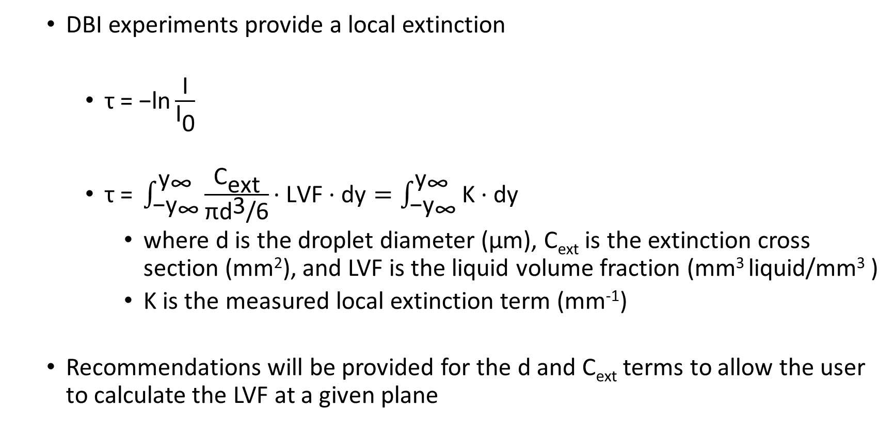
Diffused Backlight Illumination (DBI) Measurements
  DBI experiments provide a local extinction
    $\text{τ}\text{ = −}\text{ln}\frac{\text{I}}{{\text{I}}_{\text{0}}}$
    $\text{τ}\text{ =} \int_{{\text{−}\text{y}}_{\text{∞}}}^{{\text{y}}_{\text{∞}}}{\frac{{\text{C}}_{\text{ext}}}{\text{π}{\text{d}}^{\text{3}}\text{/6}}\text{∙} \text{LVF}\text{ ∙ }\text{dy}=\int_{{\text{−}\text{y}}_{\text{∞}}}^{{\text{y}}_{\text{∞}}}{\text{K}\text{ ∙ }\text{dy}}}$
      where d is the droplet diameter (μm), C_{ext} is the extinction cross section (mm²), and LVF is the liquid volume fraction (mm³ liquid/mm³ )
      K is the measured local extinction term (mm⁻¹)
  Recommendations will be provided for the d and C_{ext} terms to allow the user to calculate the LVF at a given plane

Slide 12
Ext_planes
Ext_planes.mat is data containing the local extinction, K, at 11 different planes (Z=12, 15, 20, 30, 40, 50, 60mm)
Variable Ext_YZ presents K at YZ plane at different time aSOI (time_vec)
Ext_XY presents K at XY plane at 7 different axial locations
Example codes available: “Ext_YZ.m” and “Ext_XY.m”
Y-Z plane at “Ext_YZ”
X-Y plane at “Ext_XY”

Slide 13
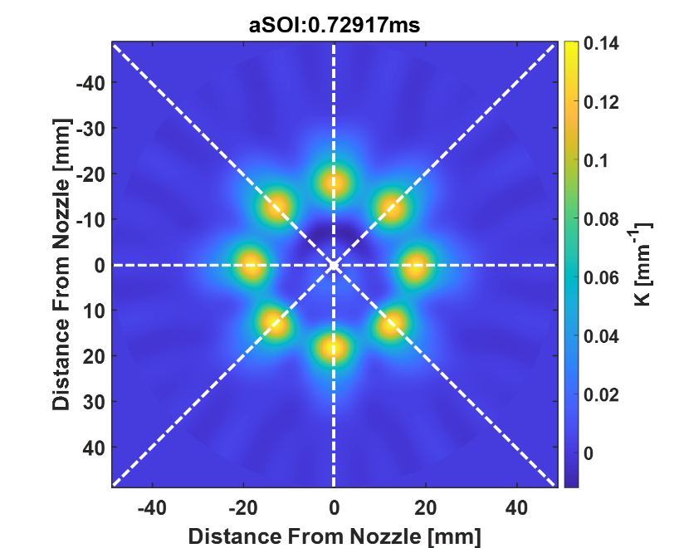
Centerline
Centerline data indicated averaged K (of 8 plumes) at 7 planes
It shows K along a radial distance through plume center
Example code available: “Ext_centerline.m”
Z= 30mm
Tomographically reconstructed spray in XY plane

Slide 14
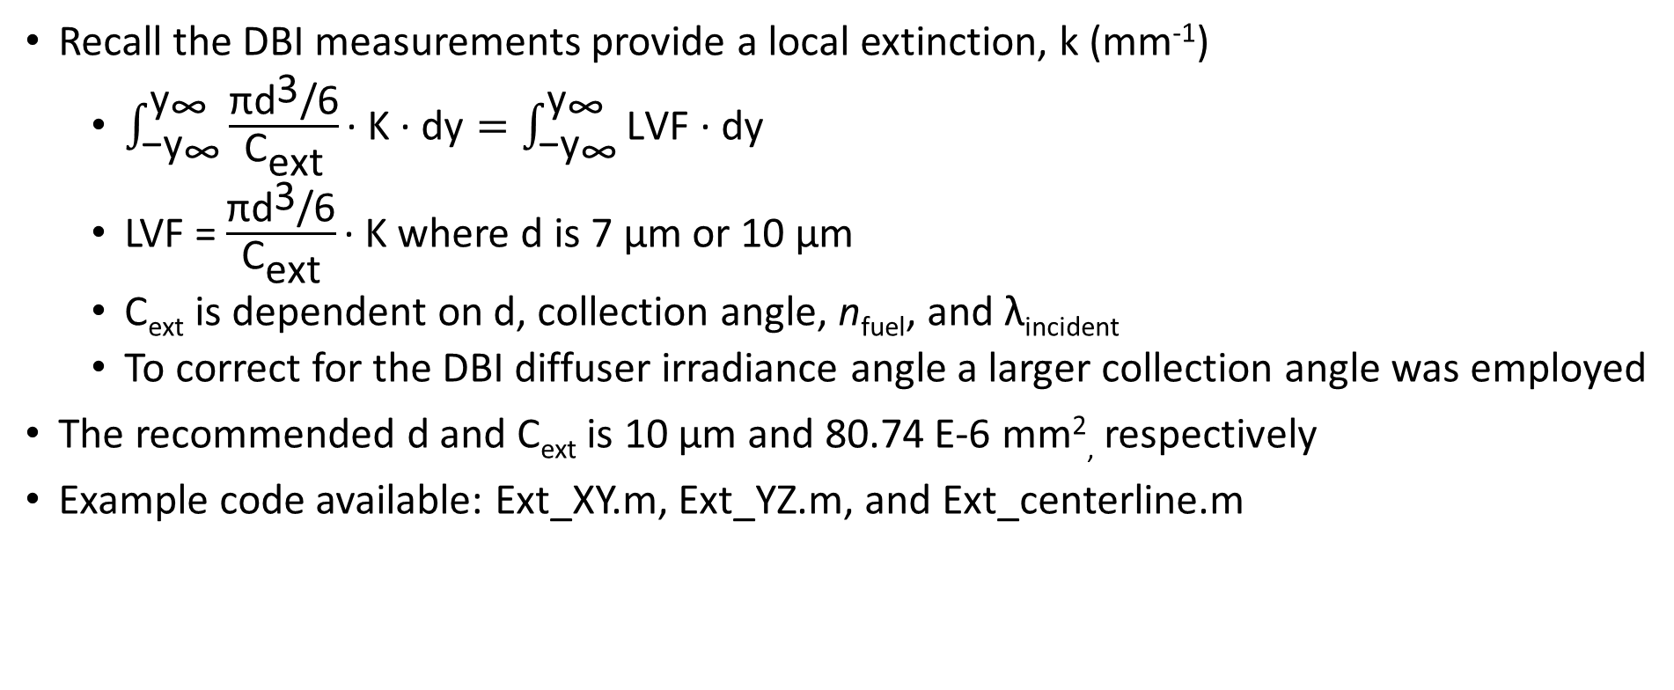
Determining the LVF
Recall the DBI measurements provide a local extinction, k (mm⁻¹)
  $\int_{{\text{−}\text{y}}_{\text{∞}}}^{{\text{y}}_{\text{∞}}}{\frac{\text{π}{\text{d}}^{\text{3}}\text{/6}}{{\text{C}}_{\text{ext}}}\text{∙} \text{K}\text{ ∙ }\text{dy}}=\int_{{\text{−}\text{y}}_{\text{∞}}}^{{\text{y}}_{\text{∞}}}{\text{LVF}\text{ ∙ }\text{dy}}$
  LVF = $\frac{\text{π}{\text{d}}^{\text{3}}\text{/6}}{{\text{C}}_{\text{ext}}}\text{∙} \text{K}$ where d is 7 μm or 10 μm
  C_{ext} is dependent on d, collection angle, n_{fuel}, and λ_{incident}
  To correct for the DBI diffuser irradiance angle a larger collection angle was employed
The recommended d and C_{ext} is 10 μm and 80.74 E-6 mm², respectively
Example code available: Ext_XY.m, Ext_YZ.m, and Ext_centerline.m

Slide 15
Plume Angles
This data presents plume center (angle) at different axial (Z) locations.
Example code available: “plume_angles.m”
Plume angle was defined by an angle from center of injector to plume center.

Slide 16
Part III: Temperature distribution under G1 condition
Sandia National Laboratories
Joonsik Hwang

Slide 17
T.mat, X.mat, Y.mat, Z.mat
Coordinates follow ECN standard.
(0,0,0) was defined at the tip of the injector.
Example code available: Chamber_T.m

